Slide 1
Session 6
NAD1001: INTRODUCTION TO ARCHITECTURAL DESIGN

Slide 3
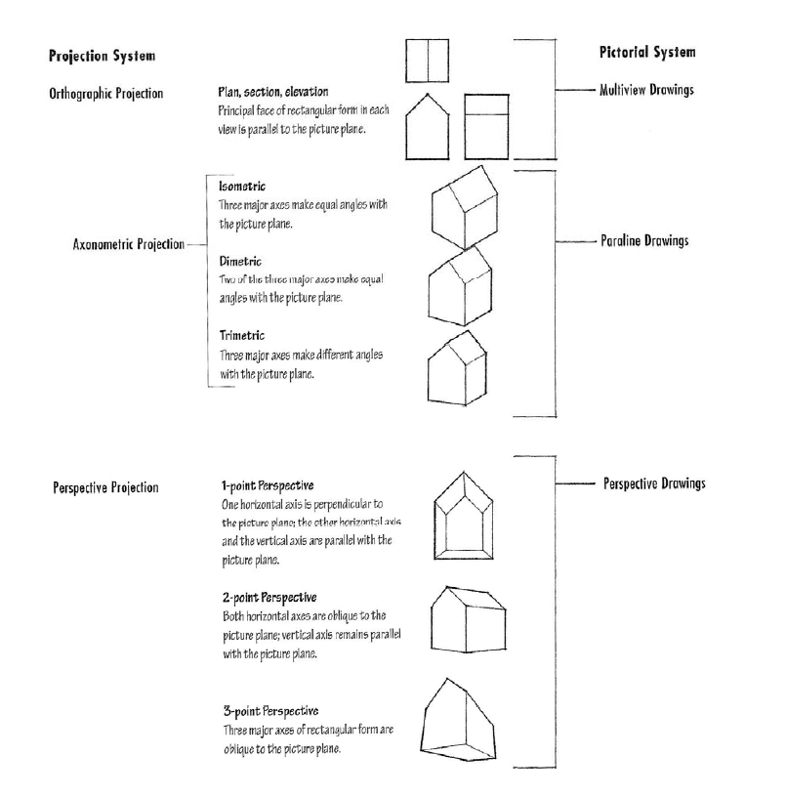
Elevation View and Other Drawings
Source: Design Drawing by Francis D. K. Ching

Slide 4
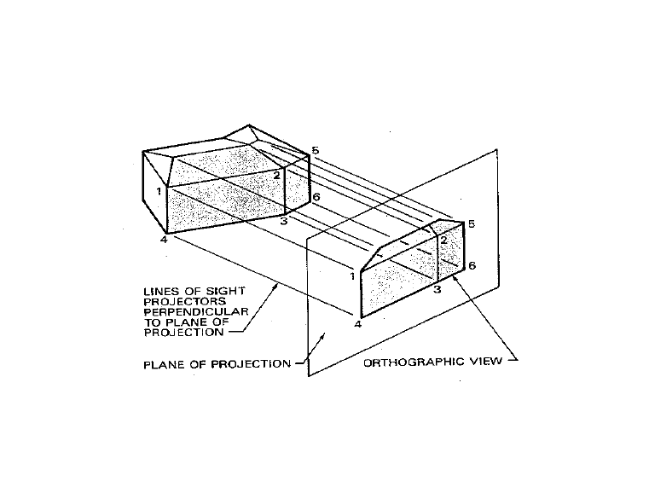
Projection System

Slide 5
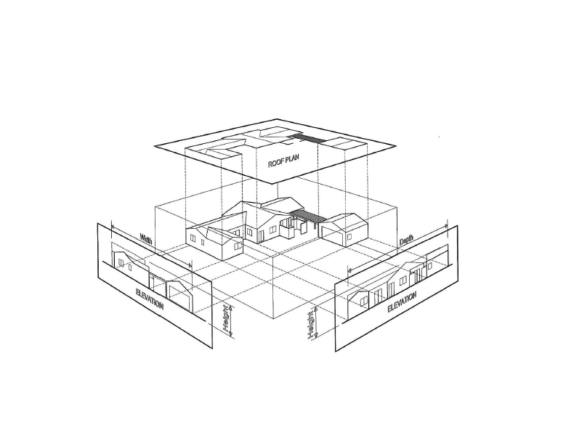
Projection System

Slide 6
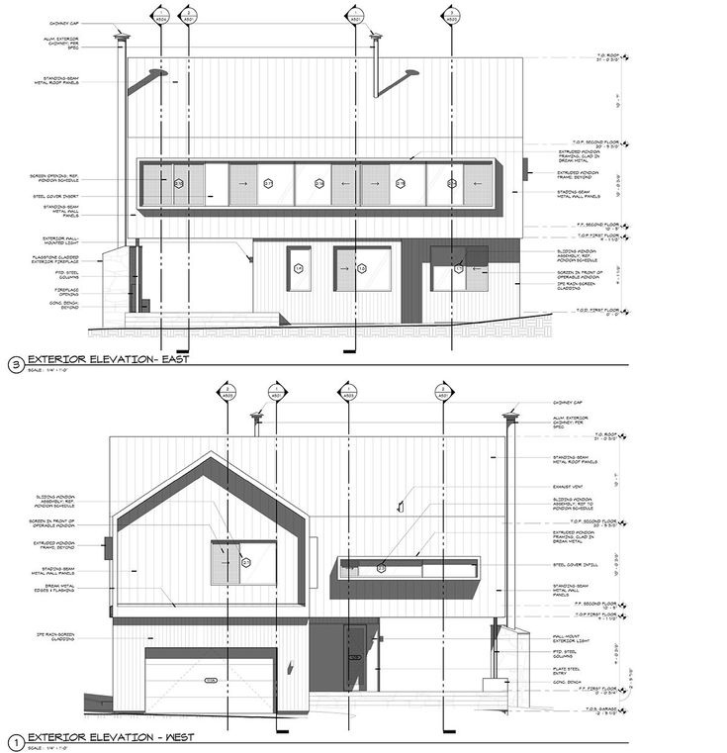
Elevation Drawing
An essential part of the design and drafting process
Elevations are orthographic drawings showing outside/exterior views of the building
Typically four(4) elevations are drafted
Information provided may include: roofing material, roof overhangs/slopes, siding or other exterior materials, chimney heights and materials, grading data, and footing depths
Source: Pinterest

Slide 7
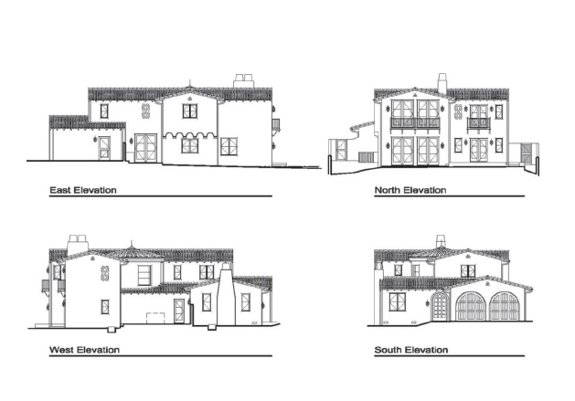
Information Contained in Elevation
The appearance of a building
Vertical dimensions
Building materials
Source: Pinterest

Slide 8
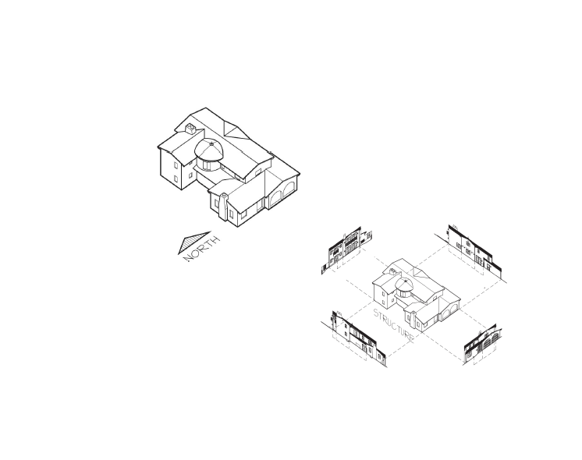
Orientation
Mechanical or engineering drafting, the elevations are described as the front, side, and rear.
In architecture, exterior elevations are called North, South, East and West.
Source: Pinterest

Slide 9
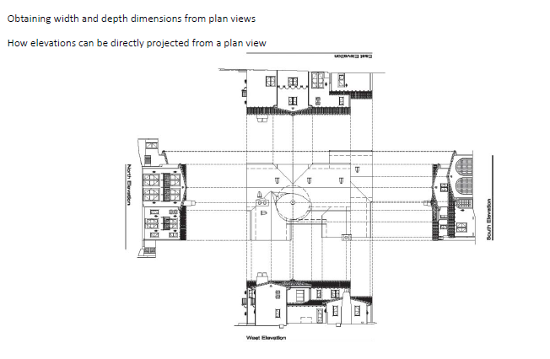
How to obtain dimensions for elevations?
You can draft exterior elevations by directly projecting sizes from the plan views or sections.

Slide 10
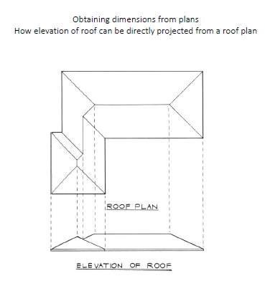
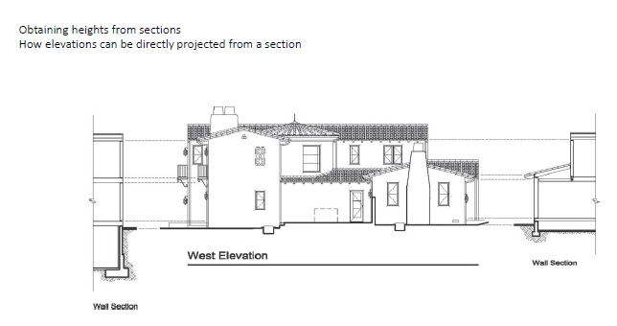
How to obtain dimensions for elevations?

Slide 11
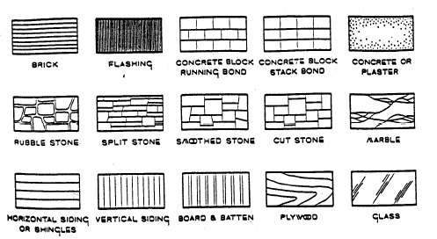
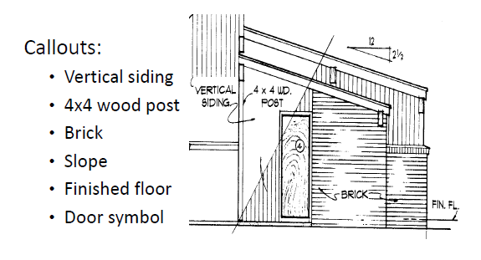
Material Detail
Source: Design Drawing by Francis D. K. Ching

Slide 12
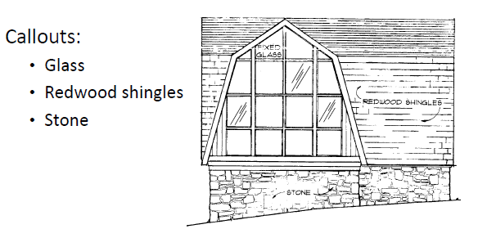
Material Detail
Source: Design Drawing by Francis D. K. Ching

Slide 13
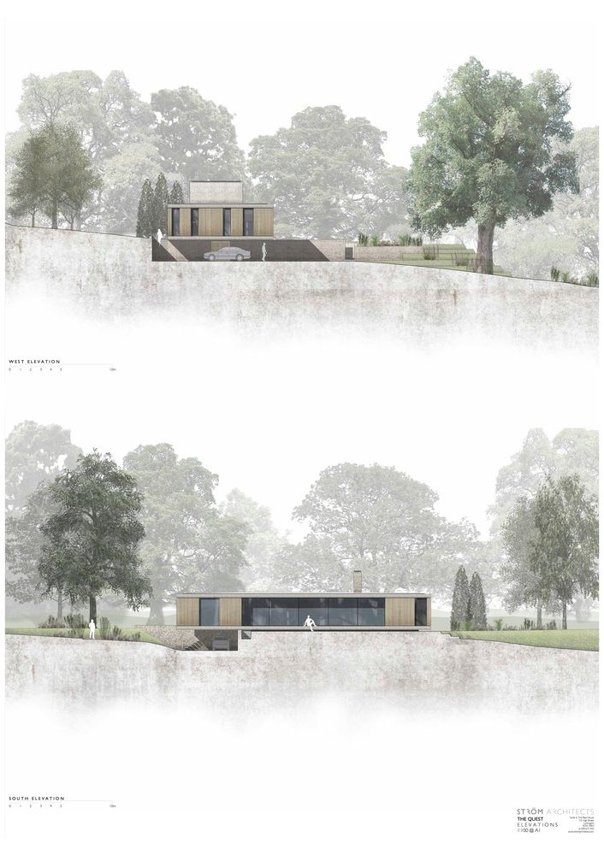
From Conceptual to Documentation
Source: Pinterest

Slide 14
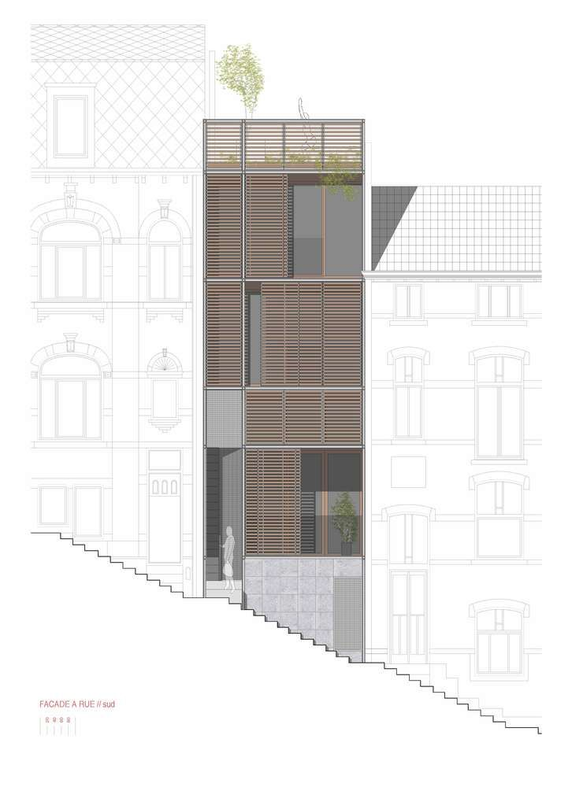
From Conceptual to Documentation
Source: Pinterest

Slide 15
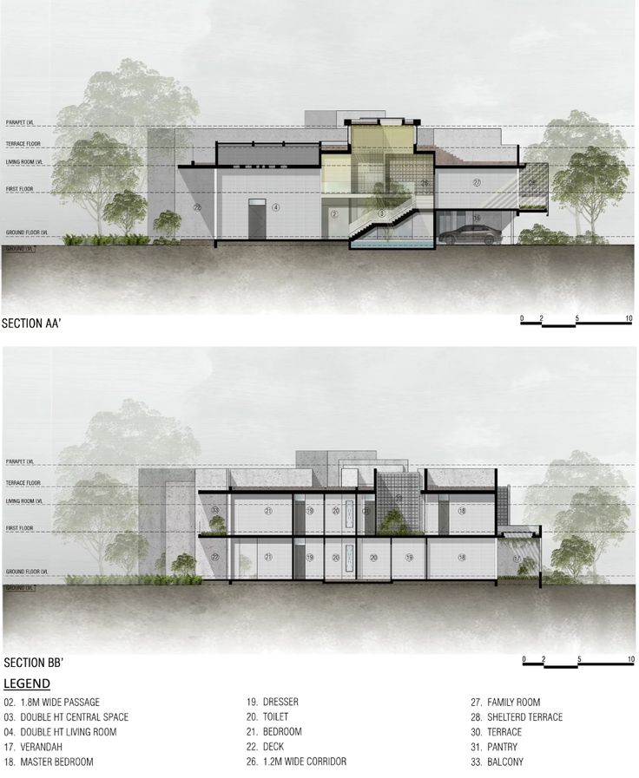
From Conceptual to Documentation
Source: Pinterest

Slide 16
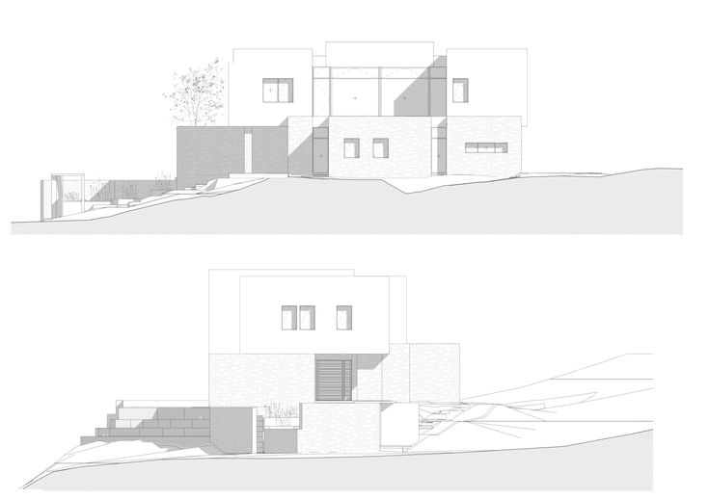
From Conceptual to Documentation
Source: Pinterest

Slide 17
From Conceptual to Documentation
Source: Pinterest

Slide 18

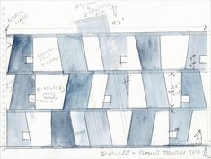
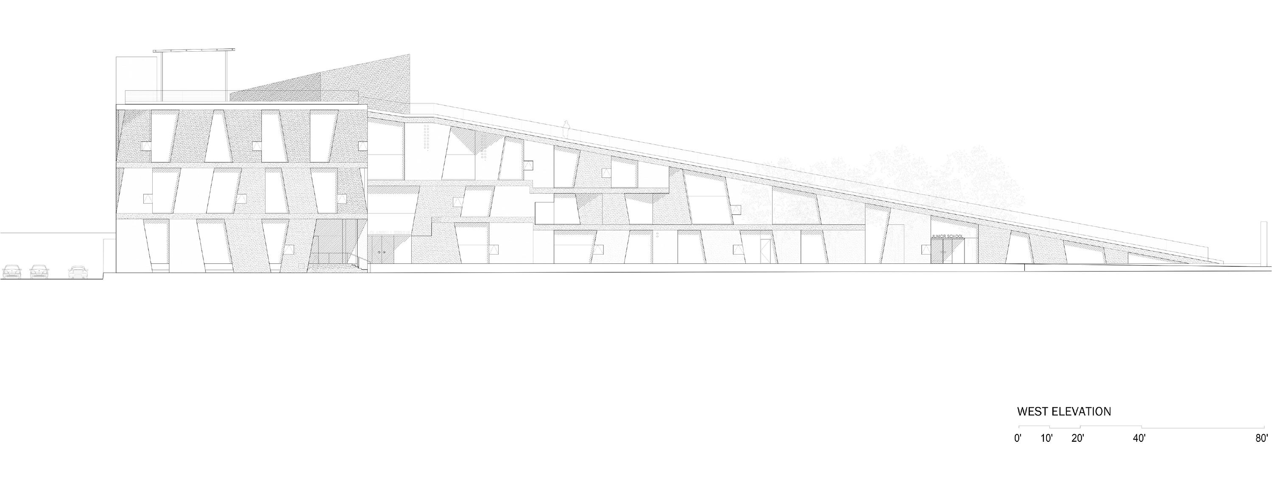
Elevation as a Key Design Driver
Steven Holl Glassell School of Art
Source: Steven Holl Architects

Slide 19
Activity: Match the Elevation

Slide 20
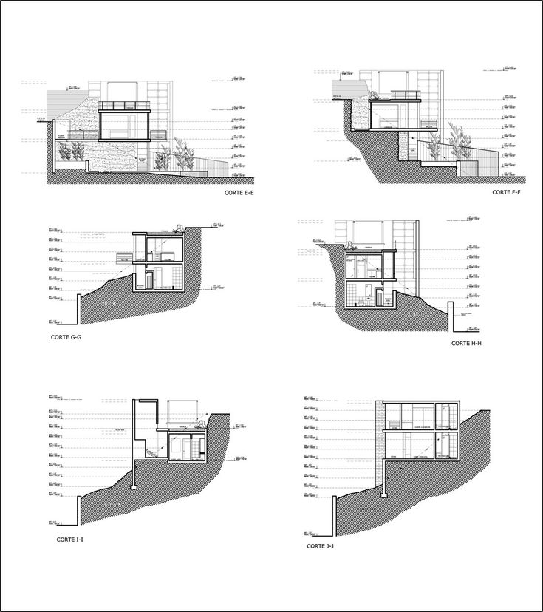
Cross Section (Section Drawing)
Definition: A section drawing cuts through a portion of a building vertically and is used to view the interior spaces.
Purpose: To show the relationships between different levels of a building, including floor and ceiling heights.
Section drawings provide insight into the vertical dimensions of spaces, helping to understand the scale and connection between different parts of the building.
Source: ArchDaily

Slide 21
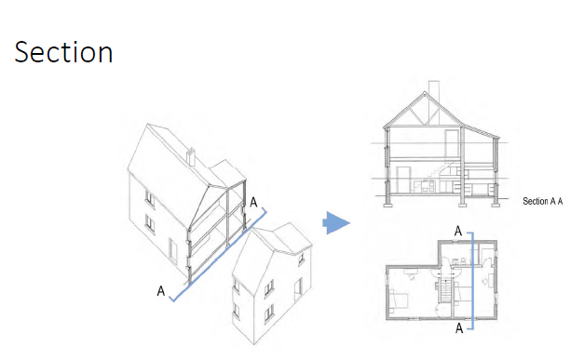
Section Cut

Slide 22
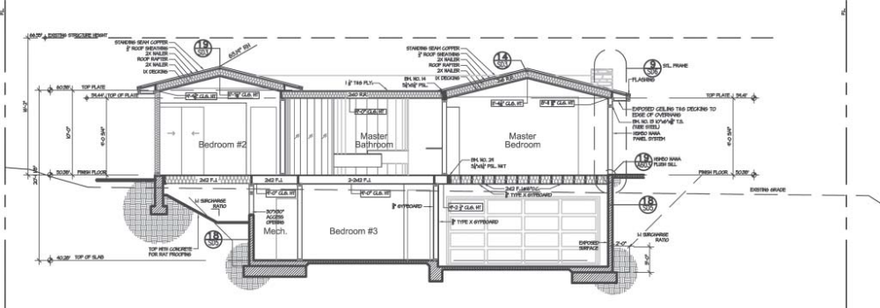
Section Cut
a vertical slice cut through a two‐story residence.
Source: ArchDaily

Slide 23
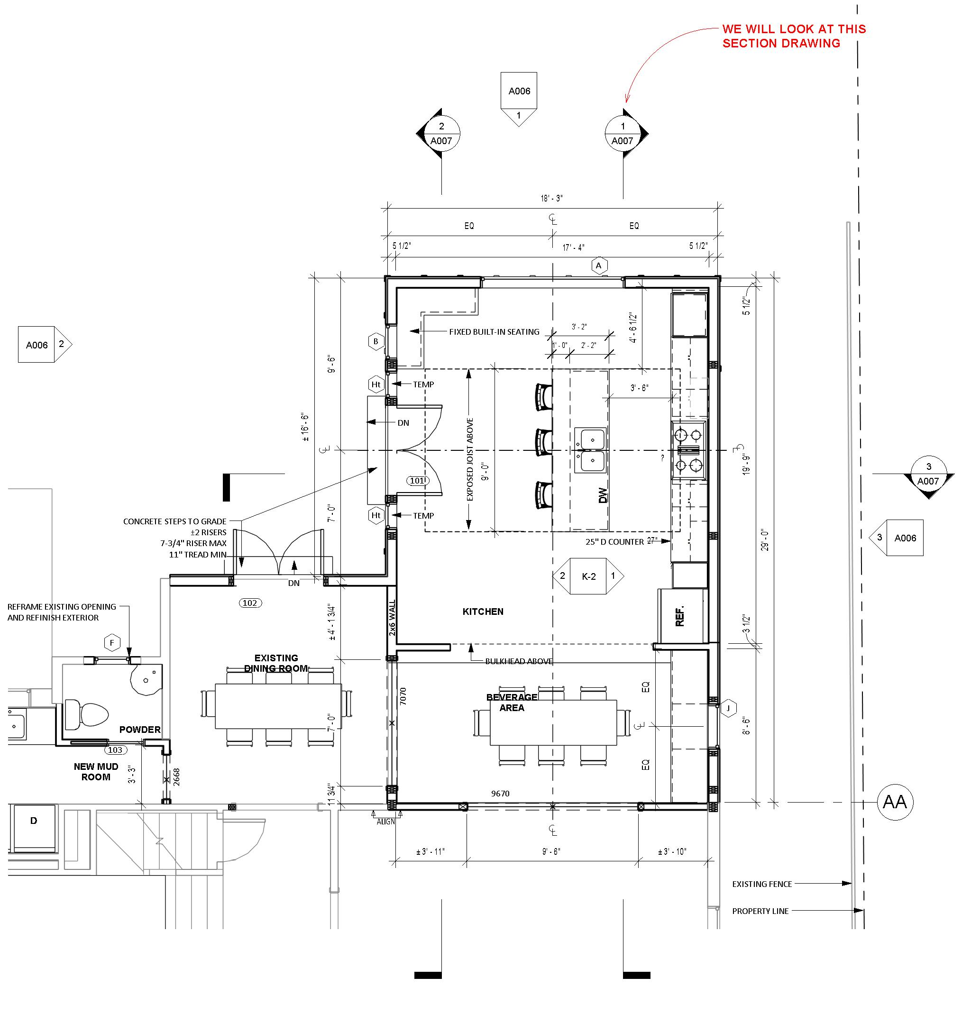
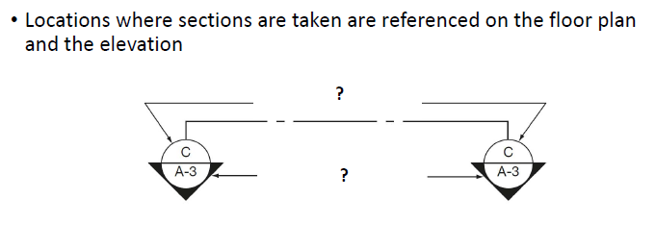
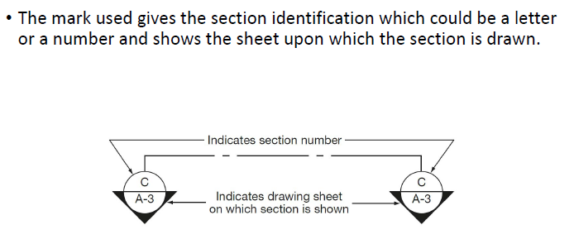
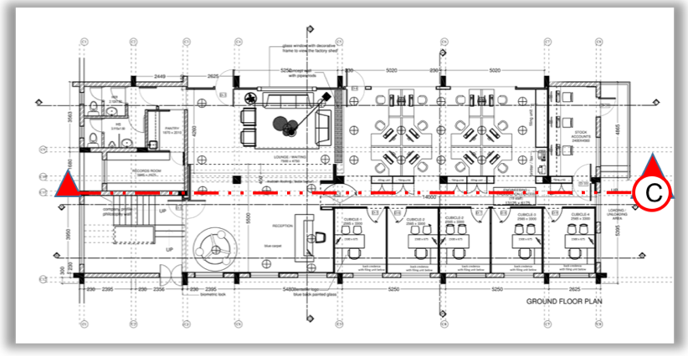
Identification of sections

Slide 24
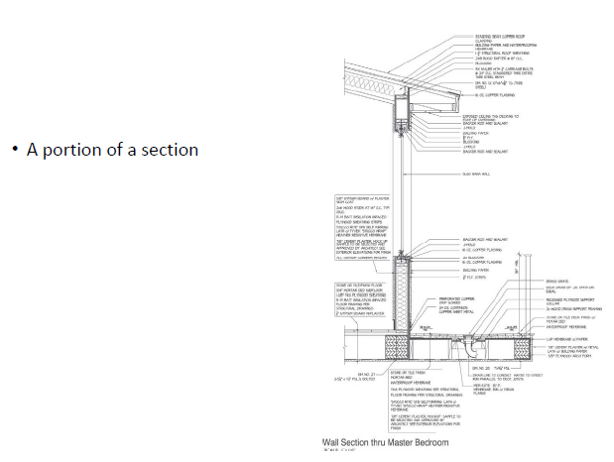
Section and Architectural Details
To further examine the various roof, floor, and wall conditions found at the location of that particular slice, we can enlarge the elements and then call it a detail.
Source: ArchDaily

Slide 25
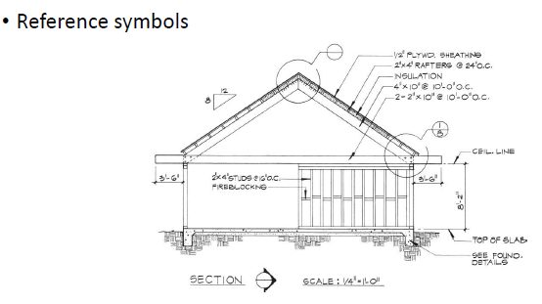
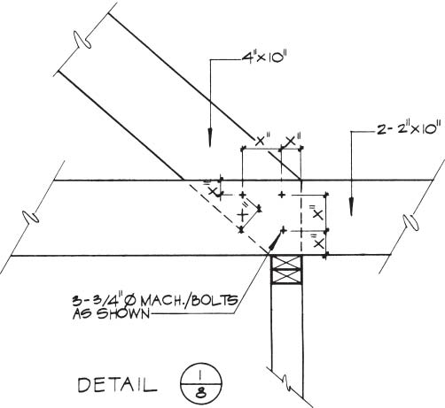
Section and Architectural Details
Source: ArchDaily

Slide 26
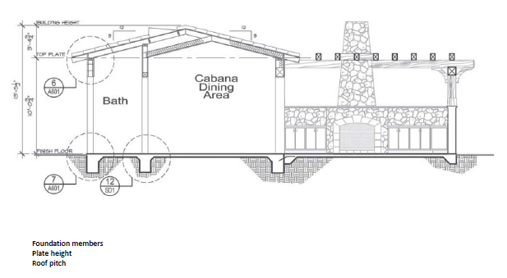
Information in Section Drawing
1. Type of foundation
2. Floor system
3. Exterior and interior wall construction
4. Beam and column sizes and their material
5. Plate or wall heights
6. Floor elevations
7. Floor members, size, and spacing
8. Floor sheathing, material, and size
9. Ceiling members, size, and spacing
10. Roof pitch
11. Roof sheathing, material, and size
12. Insulation requirements
13. Finished roof material
14. Ceiling heights
Source: ArchDaily

Slide 27
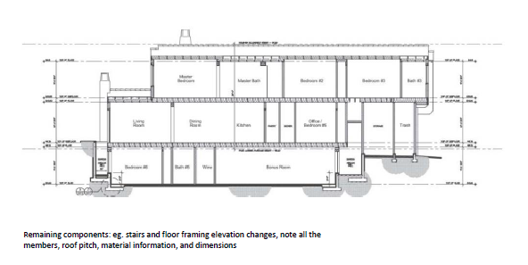
Information in Section Drawing
1. Type of foundation
2. Floor system
3. Exterior and interior wall construction
4. Beam and column sizes and their material
5. Plate or wall heights
6. Floor elevations
7. Floor members, size, and spacing
8. Floor sheathing, material, and size
9. Ceiling members, size, and spacing
10. Roof pitch
11. Roof sheathing, material, and size
12. Insulation requirements
13. Finished roof material
14. Ceiling heights

Slide 28
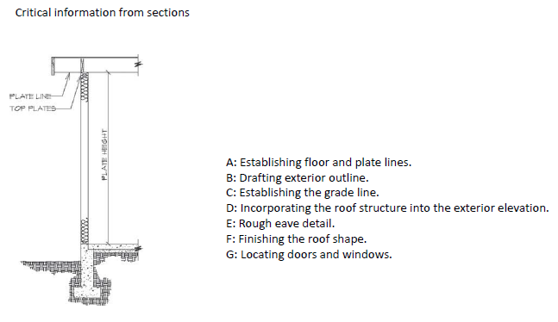
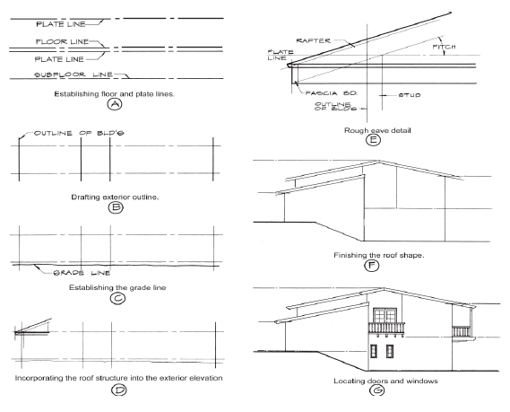
Other Information from Sections

Slide 29
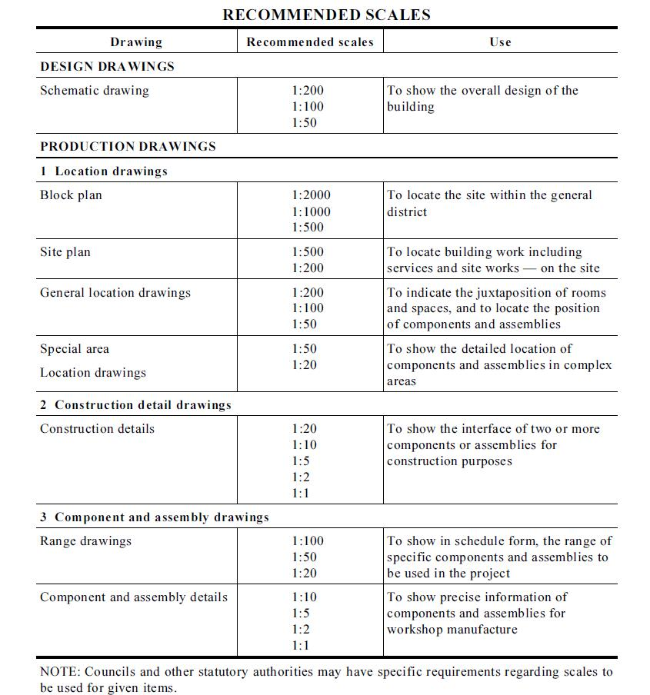
Section Scale V.S. Section Detail Scale
The number of sections required varies, depending on the design and structural complexity of the building.
Source: VCE Technical Drawing Speciﬁcations

Slide 30
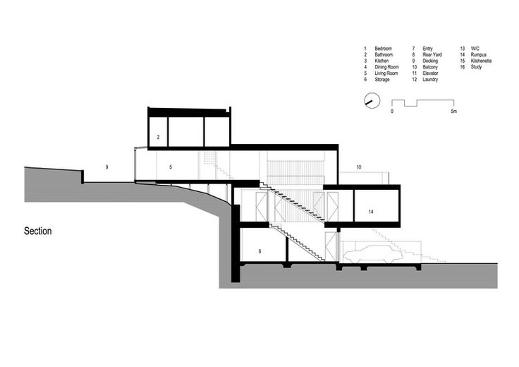
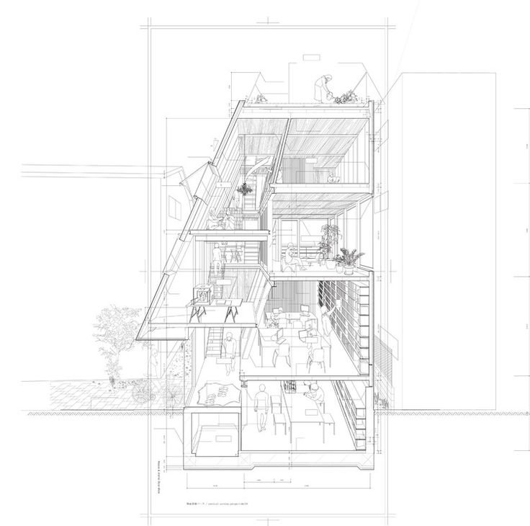
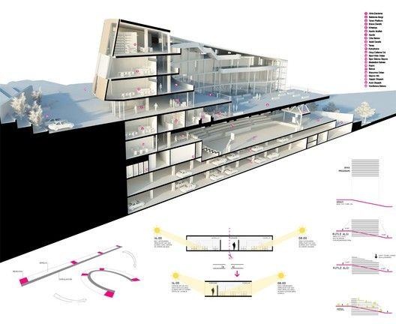
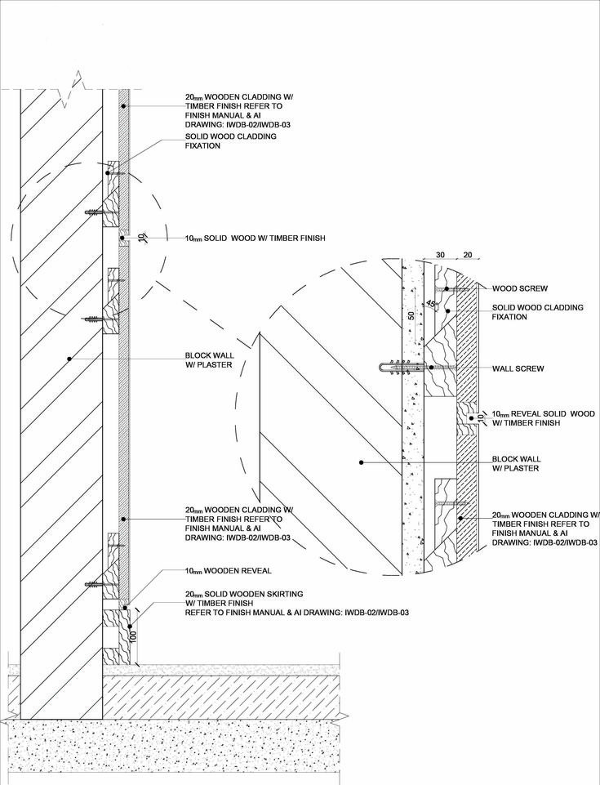
Section Typology
Match the type of section drawing
1. 2D section
2. Rendered section
3. Section perspective
4. Section detail (construction drawing)
Source: ArchDaily

Slide 31
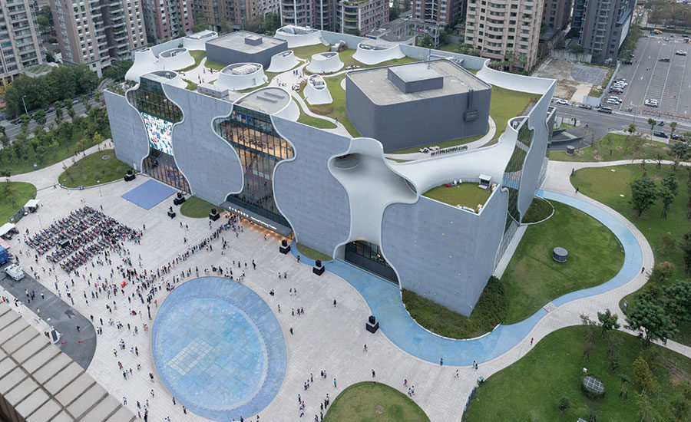
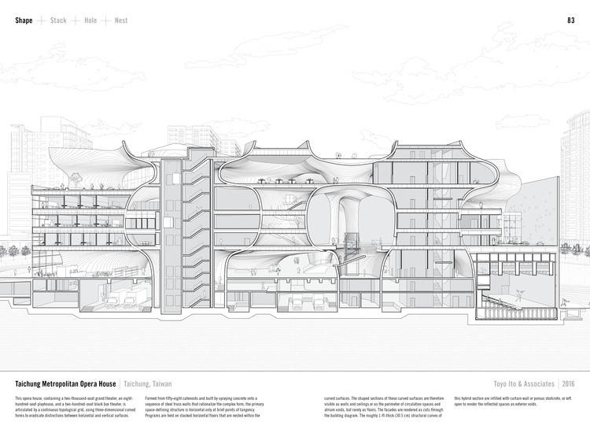
Design with Section
Section can also be a design method.
Source: Manual of Section

Slide 32

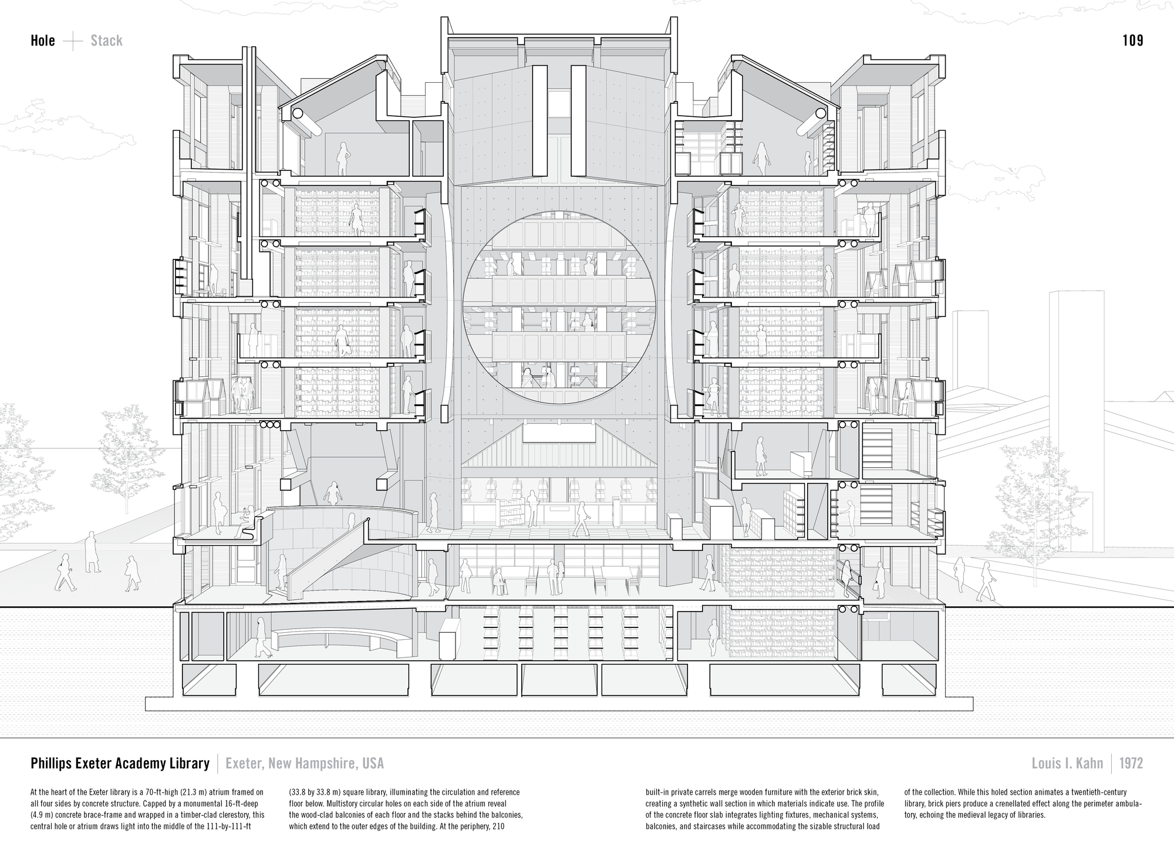
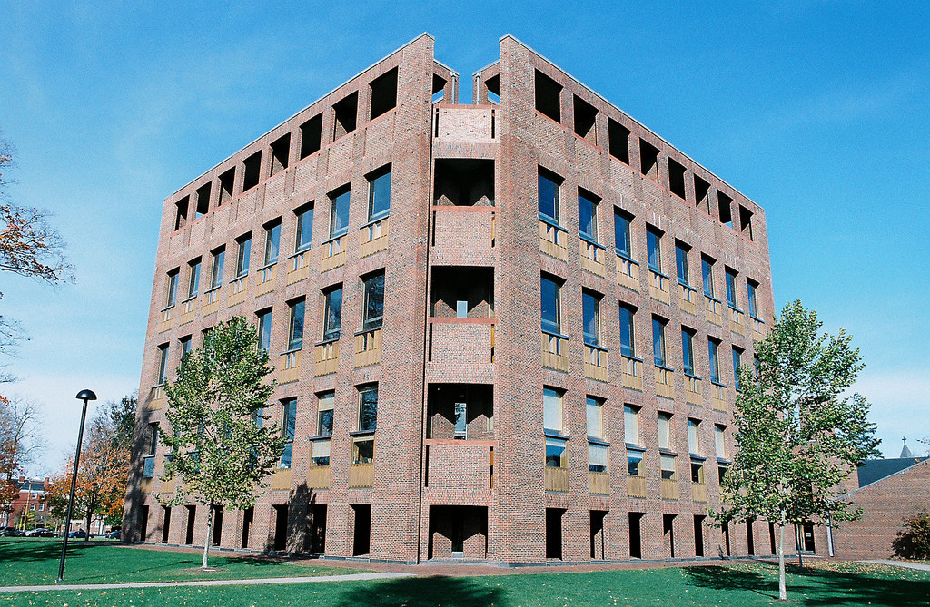
Design with Section
Section can also be a design method.
Source: Manual of Section

Slide 33
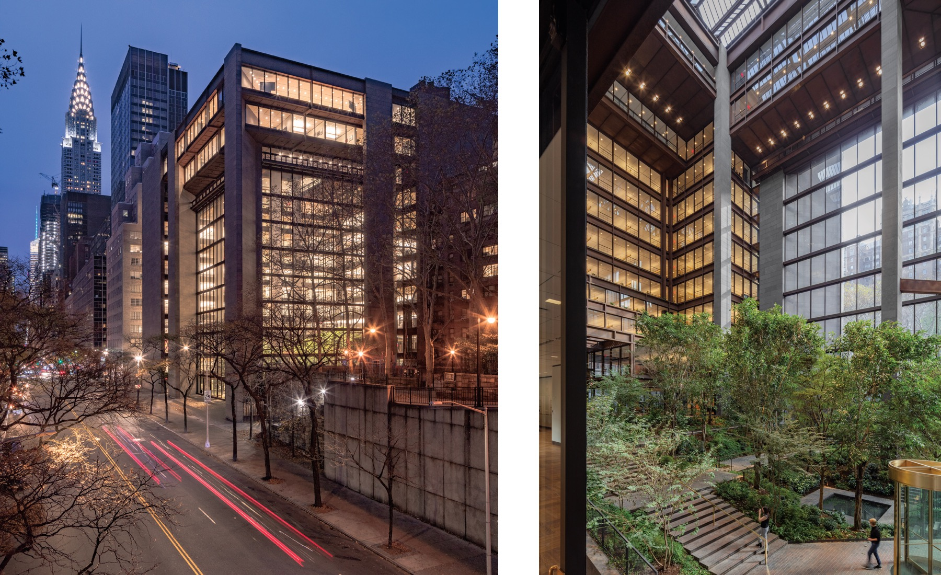
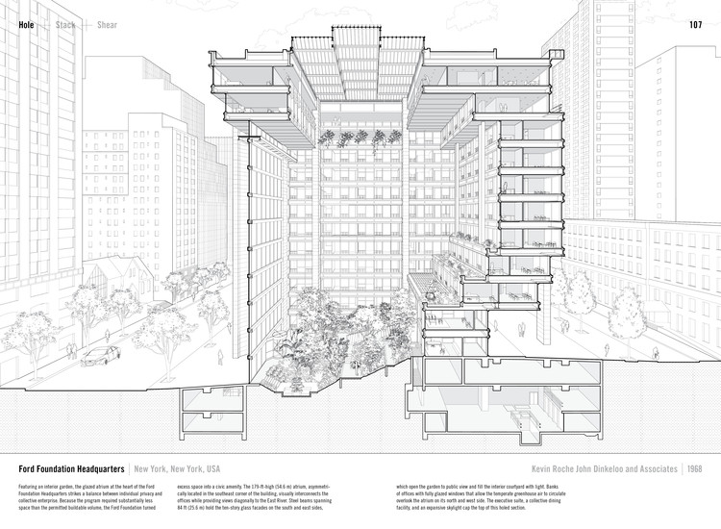
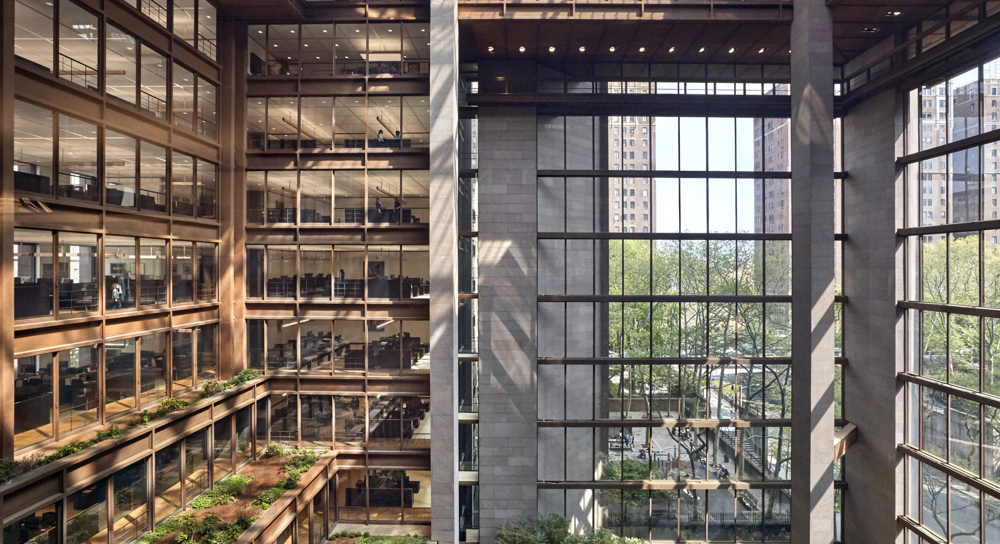
Design with Section
Section can also be a design method.
Source: Manual of Section

Slide 34
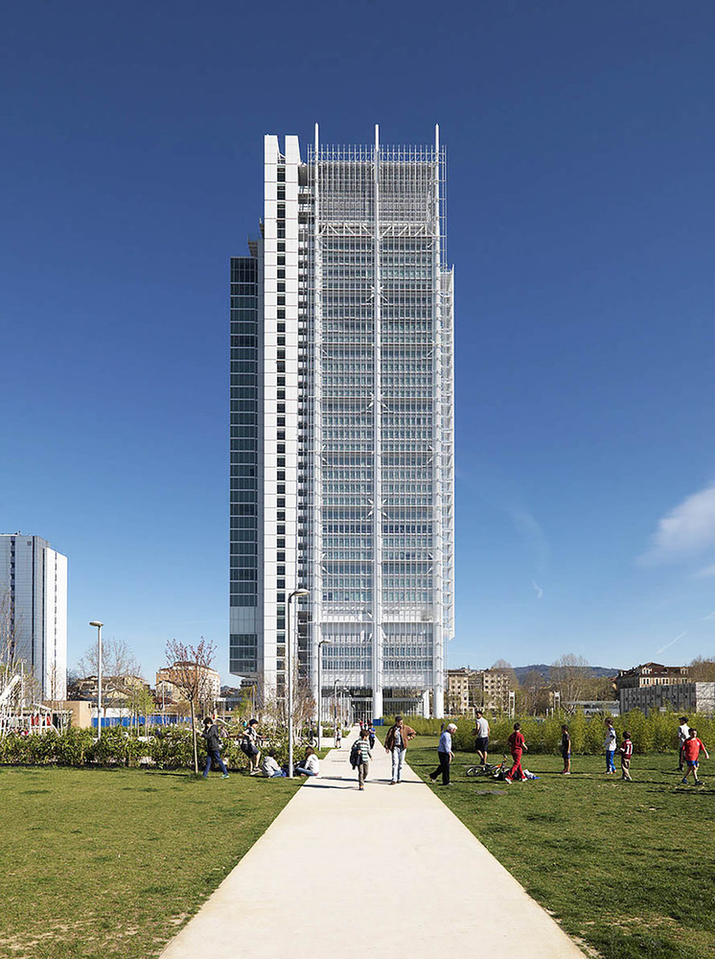

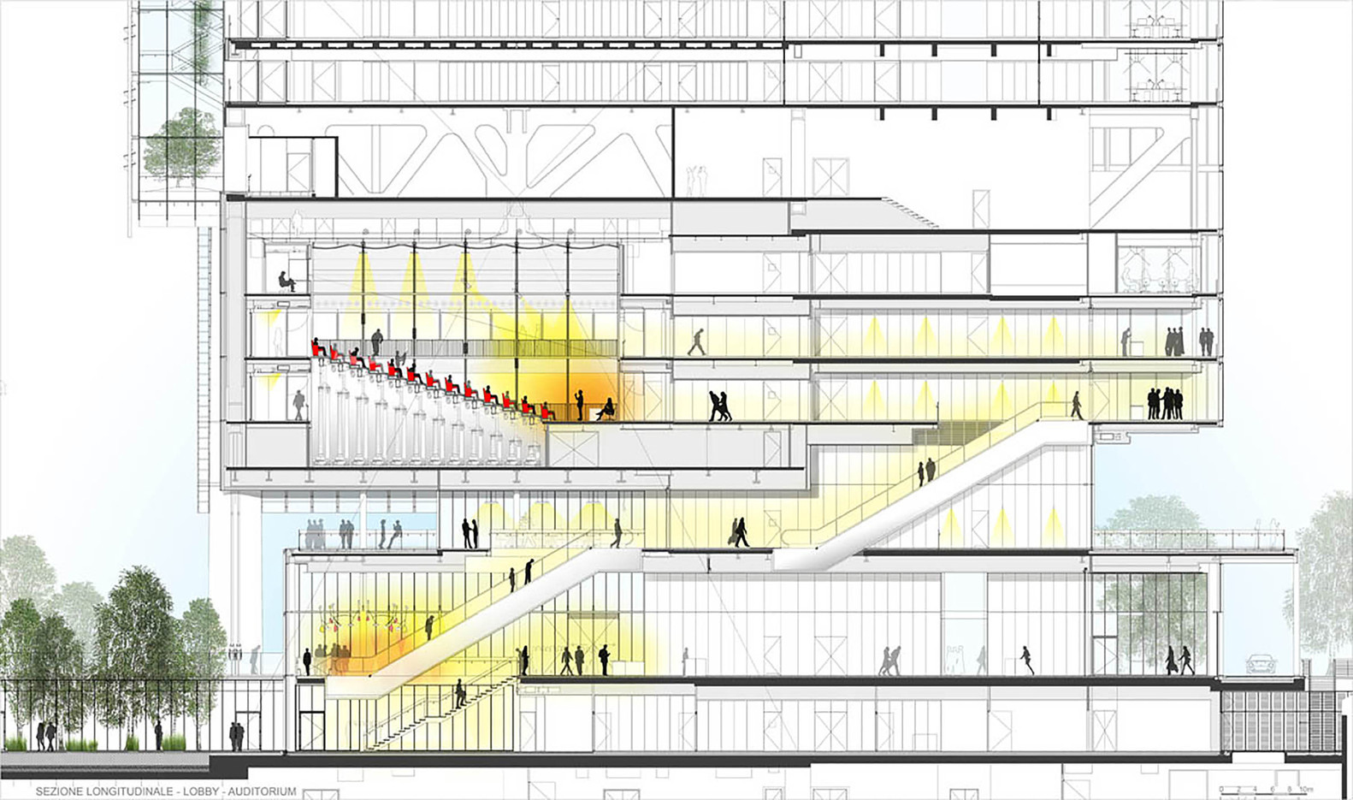
Section Showcase
Intesa Sanpaolo Office Building – Renzo Piano
Source: ArchDaily

Slide 35
Now to the technical – Ways to Produce Section Drawing
Hand Sketch
https://www.youtube.com/watch?v=98PALn5XG0U
3D Modeling or 2D Modeling then Photoshop (standard workflow)
https://www.youtube.com/watch?v=bDl91Z3v5RY
We will learn this when we use REVIT.
More discussions will come when we talk about documentation in week 3. Australian standard does address section and elevation drawings.

Slide 36
Activity: Section Exercise

Slide 37
References
Pinterest. (2025). Pinterest Image. https://www.pinterest.com/
Steven Holl Architects. (2025). Steven Holl Projects. https://www.stevenholl.com/
Ching, F. (2023). Design Drawing. Wiley
Pinterest. (2025). Pinterest Image. https://www.pinterest.com/
Arch Daily. (2025). Arch Daily Image. https://www.archdaily.com/
Lewis, P. (2016). Manual of Section. Princeton Architectural Press
Victorian Curriculum and Assessment Authority. (2018). Technical Drawing Specifications Resource: A guide to support VCE Visual Communication Design study design 2018–22. https://www.scribd.com/document/383339569/VCE-Technical-Drawing-Specs

Slide 38
Thank you
Questions?

